Slide 1
London.
Famous
People.
English
Grammar.
Do you know?
Geographical
Outlook.
100
100
100
100
100
200
200
200
200
200
300
300
300
300
300
400
400
400
400
400
500
500
500
500
500

Slide 2
What is the town of Oxford famous for?
a) For its Universities
b) For its factories
c) Queen was born there
d) It is the biggest city in england

Slide 3
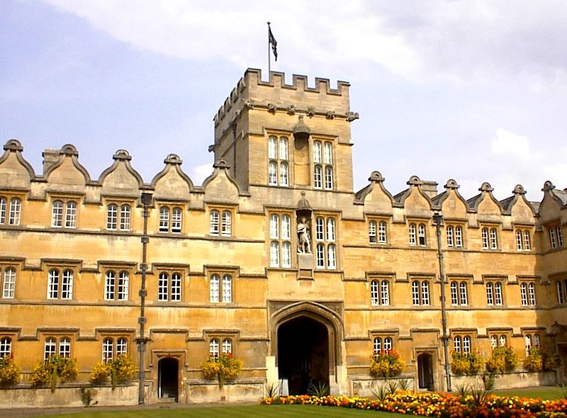
For its Universities.
The city is known worldwide as the home of Oxford University, the oldest university in the English-speaking world.
100

Slide 4
What is Big Ben?
a) It is the clock on the Houses of Parliament.
b) It is the bell of the clock on the Houses of Parliament.
c) It is the bell of the clock on the Westminster Abbey.
d) It is the clock on the Westminster Abbey.

Slide 5
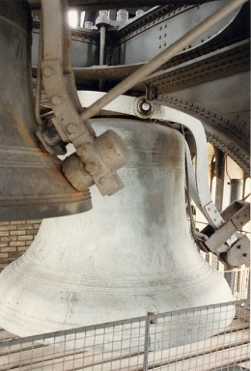
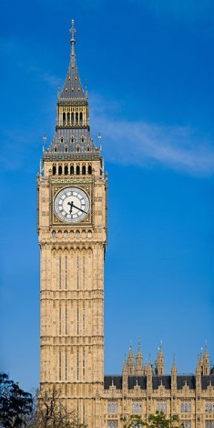
B) Big Ben is the bell of the clock on the Houses of Parliament.
Big Ben is the nickname for the Great Bell of the clock.
200

Slide 6
What park is London Zoo in?
a) HYDE PARK
B) Royal park
C) St. James's Park
D) Regent's Park

Slide 7
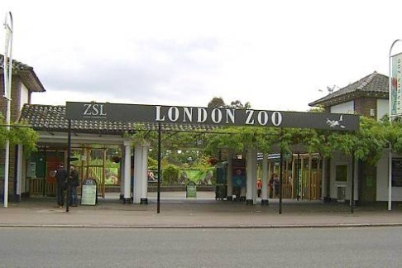
D) LONDON ZOO IS SITUATED IN Regent's Park.
The Regent's Park contains Regent's University London and the London Zoo.
300

Slide 8
It's one of the famous bridges across the Thames.
a) SMALL BRIDGE
B) TOWER BRIDGE
C) GREEN BRIDGE
D) KING’S BRIDGE

Slide 9
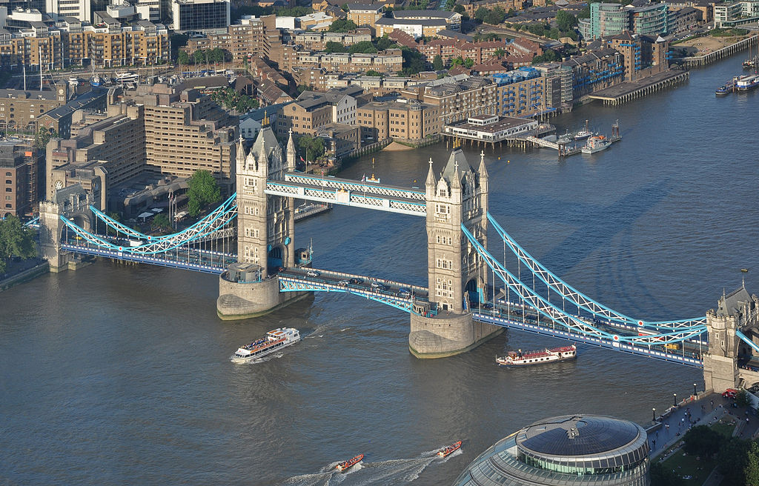
B) One of the famous bridges across the Thames is Tower Bridge.
It is close to the Tower of London, from which it takes its name, and has become an iconic symbol of London.
400

Slide 10
What birds live in the Tower of London?
a) RAVENS
b) SPARROWS
c) DUCKS
d) CHICKENS

Slide 11
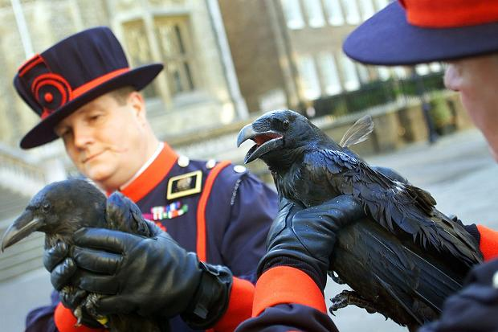
a) Ravens
A superstition holds that "If the Tower of London ravens are lost or fly away, the Crown will fall and Britain with it.”
500

Slide 12
What is the Queen's name?
a) Queen Elizabeth I
b) Queen Elizabeth II
c) Queen Mary I
d) Queen Ann I

Slide 13
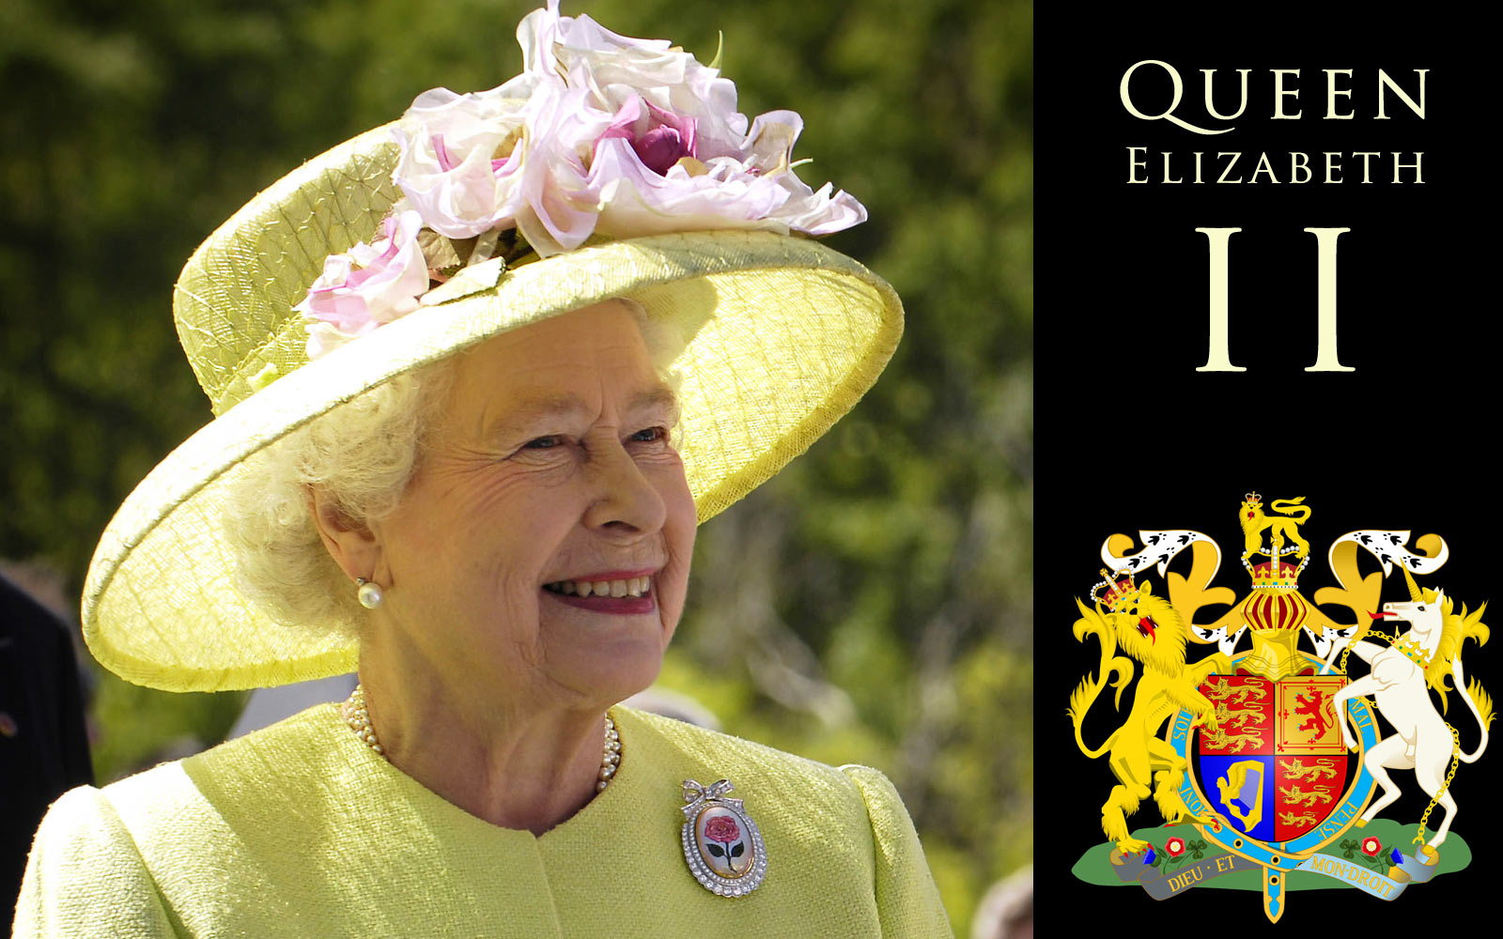
b) Queen Elizabeth II
Elizabeth II is the Queen of 16 of the 53 member states in the Commonwealth of Nations.

Slide 14
Which famous English writer's name is Charles?
a) Dickens
b) Defoe
c) Hamlet
d) Carrol

Slide 15
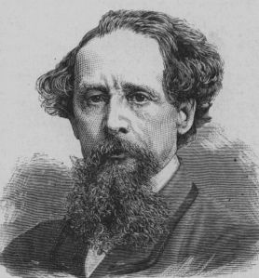
a) Dickens
Charles John Huffam Dickens was an English writer and social critic.

Slide 16
This English biologist created theory of evolution.
a) Charles Dickens
b) George Buffon
c) Charles Darwin
d) Ernest Hackel

Slide 17
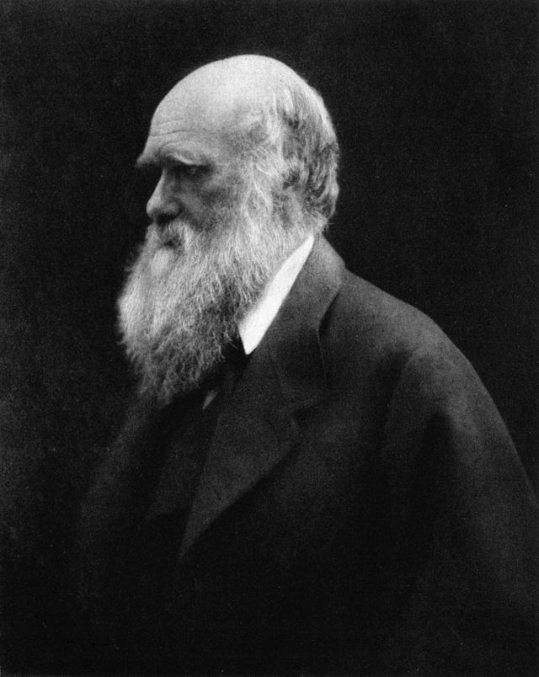
c) Charles Darwin
Charles Robert Darwin, was an English naturalist and geologist, best known for his contributions to evolutionary theory.

Slide 18
Who is the creator of the characters of Dr. Watson and Sherlock Holmes?
a) Charles Dickens
b) Lewis Carrol
c) Sir Arthur Conan Doyle
d) William Shakespeare

Slide 19
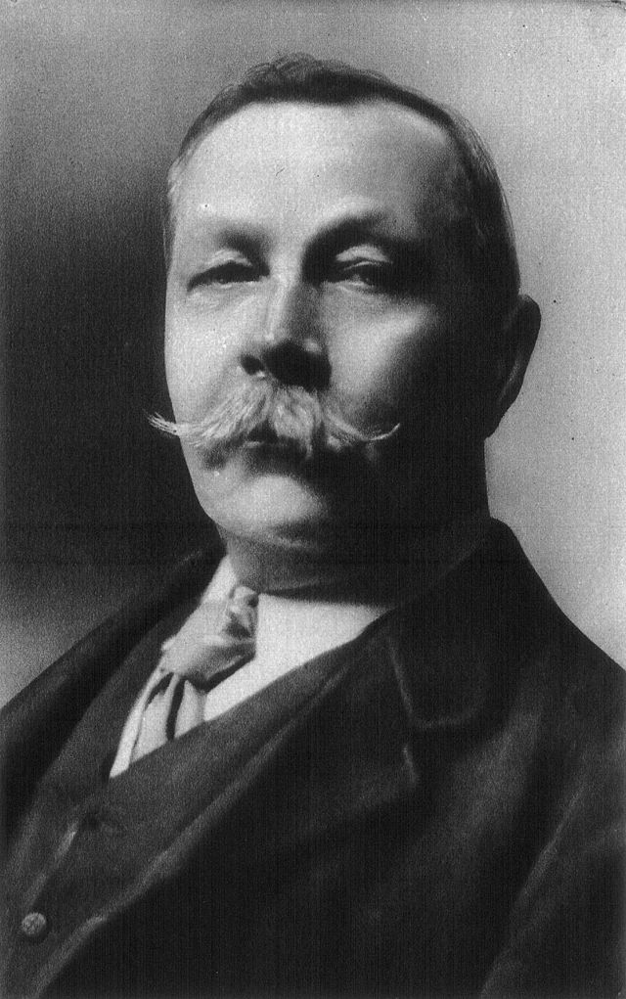
c) Sir Arthur Conan Doyle
Sir Arthur Ignatius Conan Doyle was a Scottish writer, most noted for his fictional stories about the detective Sherlock Holmes.

Slide 20
What is Madam Tussaud's Museum famous for?
a) The Models of dinosaurs.
b) The old books.
c) The Moving Images.
d) The wax figures of famous people.

Slide 21
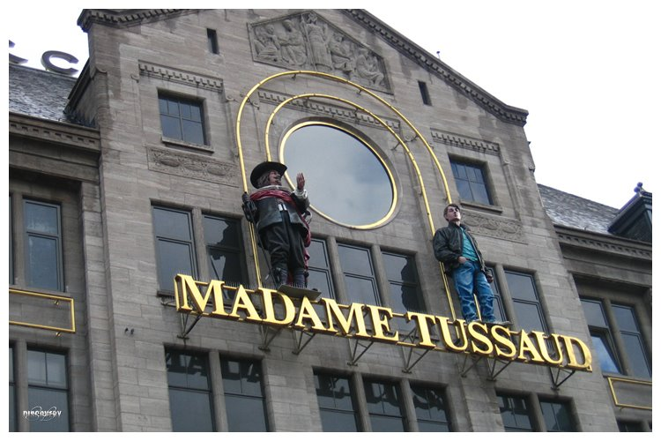
d) The wax figures of famous people.
There are a lot of figures of famous people which made from the wax .

Slide 22
Choose the correct word.
These are ________ .
a) Childs
b) Children
c) Child
d) Childrens

Slide 23
B) These are children .
Child-singular form.
Children-plural form.

Slide 24
What tense is it?
We were tired because we had to get up very early today.
a) Past Simple
b) Present Simple
c) Past Perfect
d) Present Perfect

Slide 25
We were tired because we had to get up very early today.
a) Past Simple

Slide 26
Find the special question.
a) Are you looking for a chance to visit London?
b) Do you hope to win Round-the-World tour?
c) Did you lose the game?
d) What clothes does your friend prefer?

Slide 27
d) What clothes does your friend prefer?
Special question means that it starts with Who, what, when, where, why, how etc.

Slide 28
Find the extra word in the line.
a) most cheerful
b) The slimmest
c) The wisest
d) More curios

Slide 29
d) More curios
“More curios” is The Comparative Degree, others are The Superlative.

Slide 30
Choose the right forms.
When I (to come) home, mother already (to cook) dinner.
a) Came, had cooked
b) Had come, cooked
c) Came, cooked
d) Had came, had cooked

Slide 31
a) Came, had cooked
When I came home, mother already had cooked dinner.

Slide 32
How do the British call their flag?
a) Jolly Roger
B) The Union Jack
C) Stars and Stripes
D) The Union Black

Slide 33
B) The Union Jack, or Union Flag, is the national flag of the United Kingdom.

Slide 34
When do British people celebrate Christmas?
a) On the 25th of December
b) On the 7th of January
c) On the 6th of January
d) On the 29th of December

Slide 35
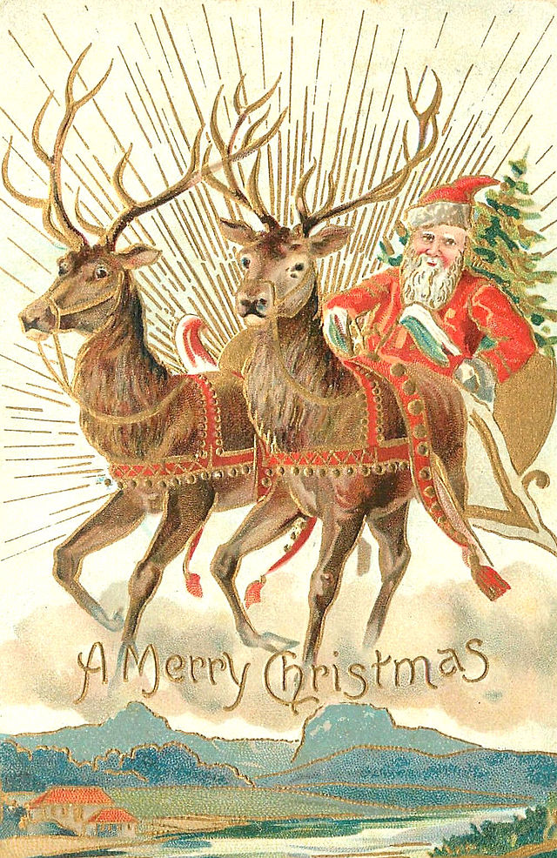
a) On the 25th of December
Some countries celebrate on the December 25 of the older Julian calendar, others in the Gregorian calendar, on January 7.

Slide 36
What is the national costume of Scotland?
a) The Kokoshnik
b) The Kimono
c) The Kilt
d) The Sari

Slide 37
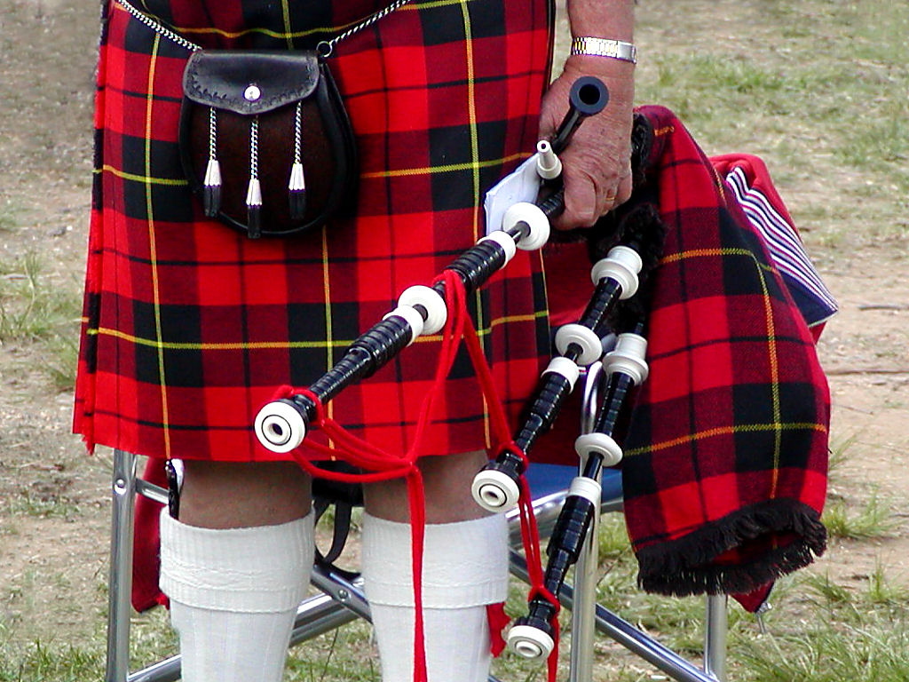
c) The Kilt.
The kilt is a knee-length garment, originating in the traditional dress of men and boys in the Scottish Highlands of the 16th century.

Slide 38
What were the first exotic animals in London Zoo?
a) Crocodiles and bears
b) Pandas and parrots
c) Tigers and kangaroos
d) Leopards and elephants

Slide 39
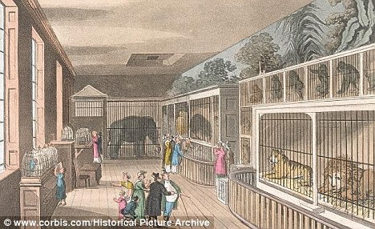
d) Leopards and elephants.
They say exotic animals were first taken to Britain in the 13 century when King Henry III received a gift of leopards and elephants.

Slide 40
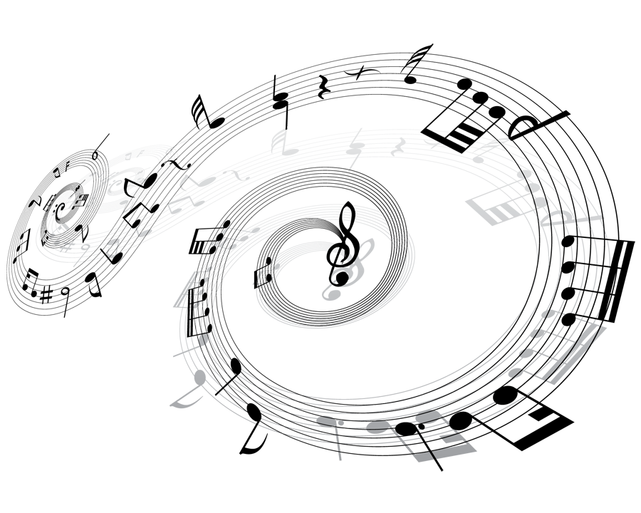
What is the name of this famous English music band?
a) The Who
b) The Beatles
c) The Queen
d) The Rolling Stones

Slide 41
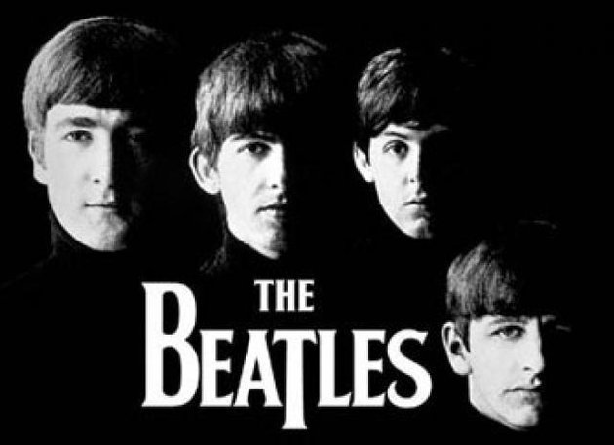
b) The Beatles
They are the best-selling band in history, with estimated sales of over 600 million records worldwide.

Slide 42
What is the official name of Great Britain?
a) The Great Britain of United Kingdom and Northern Ireland
b) The United Kingdom of Great Britain and Western Ireland
c) The United Kingdom of Great Britain and Northern Ireland
d) The Republic of Great Britain and Northern Ireland

Slide 43
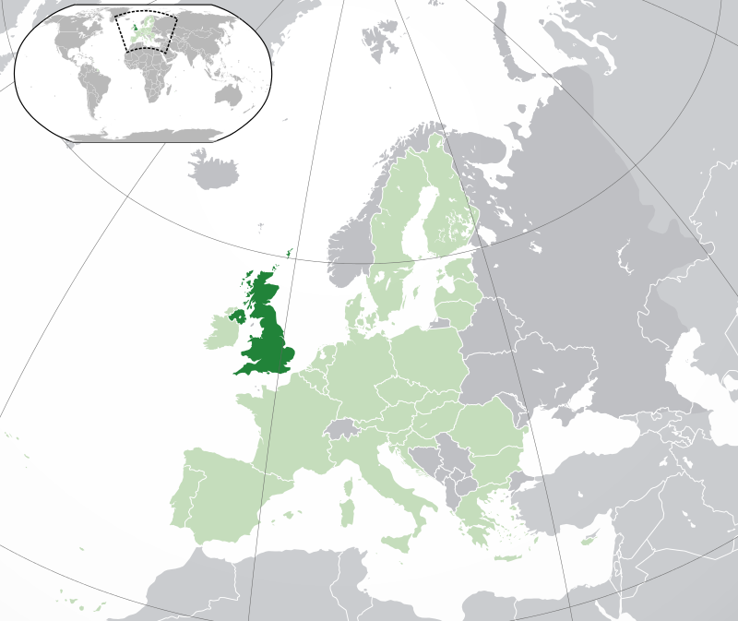
c) The United Kingdom of Great Britain and Northern Ireland
The United Kingdom of Great Britain and Northern Ireland, commonly known as the United Kingdom (UK) or Britain.

Slide 44
What is the largest island of the British Isles?
a) The Bahamas
b) Jamaica
c) Malta
d) Ireland

Slide 45
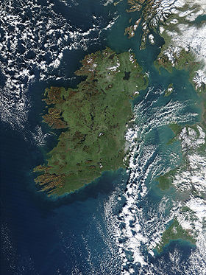
d) Ireland
Northern Ireland is a part of the United Kingdom.

Slide 46
What is the capital of Scotland?
a) Edinburgh
b) Cardiff
c) Belfast
d) London

Slide 47
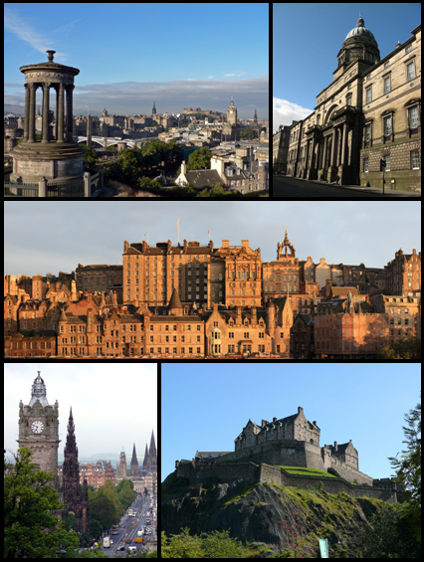
a) Edinburgh
It is the second most populous city in Scotland and the seventh most populous in the UK.

Slide 48
How many parts does the United Kingdom consist of?
a) 1
b) 2
c) 3
d) 4

Slide 49
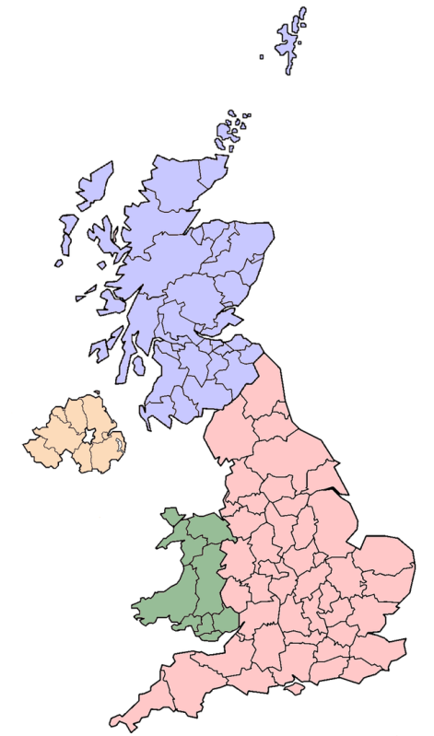
d) 4
The UK consists of four countries: England, Scotland, Wales, and Northern Ireland.

Slide 50
What is the title of national hymn of the UK?
a) “We Save the King"
b) "God Save the Queen"
c) "God Save Great Britain"
d)"God Save the royal family"

Slide 51
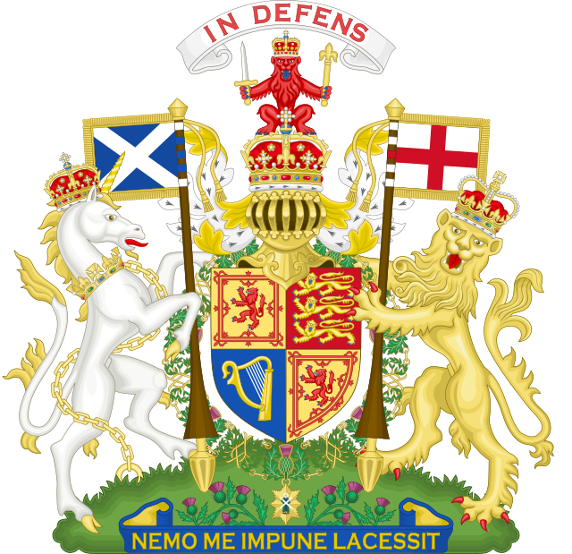
b) "God Save the Queen"
The national anthem of the United Kingdom is "God Save the King", with "King" replaced with "Queen"

